Slide 1
進度報告
Anti-spoofing

Slide 2
Progress
跑完實驗 – 補數據
Demo system – 加入filter
Multi-filter
Comparison

Slide 3
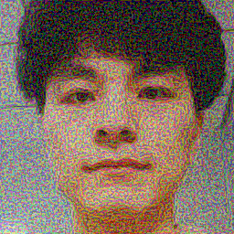

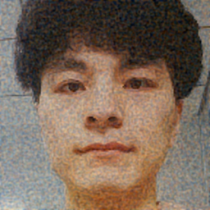
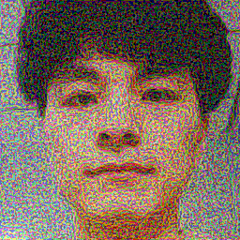
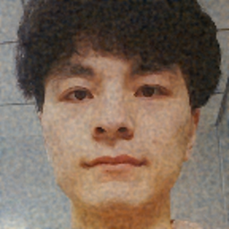
Multi-filter
 | Filter * 1 | Filter * 2
sigma=0.8 eps=0.3 | 0.3893 / 0.6526
sigma=0.8 eps=0.4 | 0.1588 / 0.5500 | 0.6264 / 0.7692
sigma=1 eps=0.3 | 0.6085 / 0.7833 | 0.5928 / 0.9179
sigma=1 eps=0.4 | 0.5638 / 0.6961 | 0.5951 / 0.8739
No filter
Filter * 1
Filter * 2
Eps = 0.3
0 / 0.1816
0.6085 / 0.7833
0.5928 / 0.9179
Eps = 0.4
0.0089 / 0.1288
0.5638 / 0.6961
0.5951 / 0.8739

Slide 4
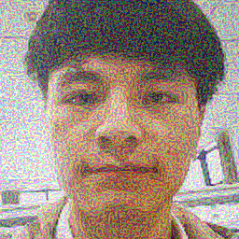





Multi-filter
 | Filter * 1 | Filter * 2
sigma=0.8 eps=0.3 | 0.0227 / 0.6630 | 0 / 0.9658
sigma=0.8 eps=0.4 | 0.0211 / 0.5615 | 0 / 0.9460
sigma=1 eps=0.3 | 0.0257 / 0.9541 | 0 / 0.9803
sigma=1 eps=0.4 | 0.0634 / 0.9276 | 0 / 0.9691
sigma=1.2 eps=0.3 | 0.0015 / 0.8696 | 0 / 0.9873
sigma=1.2 eps=0.4 | 0.0211 / 0.8067 | 0 / 0.9804
sigma=1.2 eps=0.5 | 0.0982 / 0.9339 | 0 / 0.9727
No filter
Filter * 1
Filter * 2
Eps = 0.3
0 / 0.1906
0.0257 / 0.9541
0 / 0.9803
Eps = 0.4
0.0423 / 0.1365
0.0634 / 0.9276
0 / 0.9691

Slide 5
Sigma / SSIM
Best model: 3D Gaussian(sigma=1) noise on FGSM
SSIM: Structure, Intensity, Contrast
Oulu-1
Oulu-2
 | 0.3 | 0.4
Sigma | ASR | SSIM | ASR | SSIM
no | 0 | 0.1816 | 0.89 | 0.1288
0.5 | 0 | 0.8660 | 0 | 0.8011
0.8 | 38.93 | 0.6526 | 15.88 | 0.5500
0.8 * 2 |  | 62.64 | 0.7692
1 | 60.85 | 0.7833 | 56.38| 0.6961
1 * 2 | 59.28 | 0.9179 | 59.51| 0.8739
1.2 | 62.64 | 0.8660 | 62.86 | 0.8011
1.4 | 60.18 | 0.9153 | 59.96 | 0.8701
2 | 37.81 | 0.9717 | 41.70 | 0.9566
 | 0.3 | 0.4
Sigma | ASR | SSIM | ASR | SSIM
no | 0 | 0.1906 | 4.23 | 0.1365
0.8 | 2.27 | 0.6630 | 2.11 | 0.5615
0.8 * 2 | 0 | 0.9658 | 0 | 0.9460
1 | 2.57 | 0.9541 | 6.34 | 0.9267
1 * 2 | 0 | 0.9803 | 0 | 0.9691
1.2 | 0.15 | 0.8696 | 2.11 | 0.8067
1.2 * 2 | 0 | 0.9873 | 0 | 0.9804
2 | 0 | 0.9716 | 0 | 0.9567

Slide 6
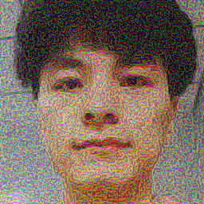




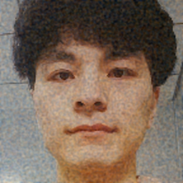

OULU-1 FGSM GAUSSIAN
ASR | SSIM
No filter
Sigma = 0.8
Sigma = 1
Filter * 2
Sigma = 1
Sigma = 1.2
Sigma = 2
Eps = 0.3
0 | 0.1816
38.93 | 0.6526
60.85 | 0.7833
59.28 | 0.9179
62.64 | 0.8660
37.81 | 0.9717
Eps = 0.4
0.89 | 0.1288
15.88 | 0.5500
56.38 | 0.6961
59.51 | 0.8739
62.86 | 0.8110
41.70 | 0.9566

Slide 7
Comparison
OULU-1
 | FGSM | iFGSM | FGSM + filter | iFGSM + filter
SSIM = 0.8 | 16 | 36.91 | 62.86 | 12.52
SSIM = 0.65 | 4.25 | 30.20 | 38.93 | 6.26
OULU-2
 | FGSM | iFGSM | FGSM + filter | iFGSM + filter
SSIM = 0.8 | 0 | 34.74 | 2.11 | 12.12
SSIM = 0.65 | 0 | 29.31 | 2.27 | 21.60

Slide 8
Conclusion
filter應用在FGSM的效果較顯著
filter應用導致iFGSM的效果變差
Filter Performance：Gaussian > Uniform
SSIM: Gaussian > Uniform > no filter
Multiple filter increase image quality
Best filter’s sigma and number
Trade-off between ASR and SSIM
Best attack: iFGSM or FGSM with Filter

Slide 9
Future Work
More comparison and conclusion
Written report

